Slide 1
DoD Safety Privilege

Slide 2

Safety Privilege Refresher
“Protecting Privileged Safety Information” video
Re-trained annually
Click image to play video.

Slide 3
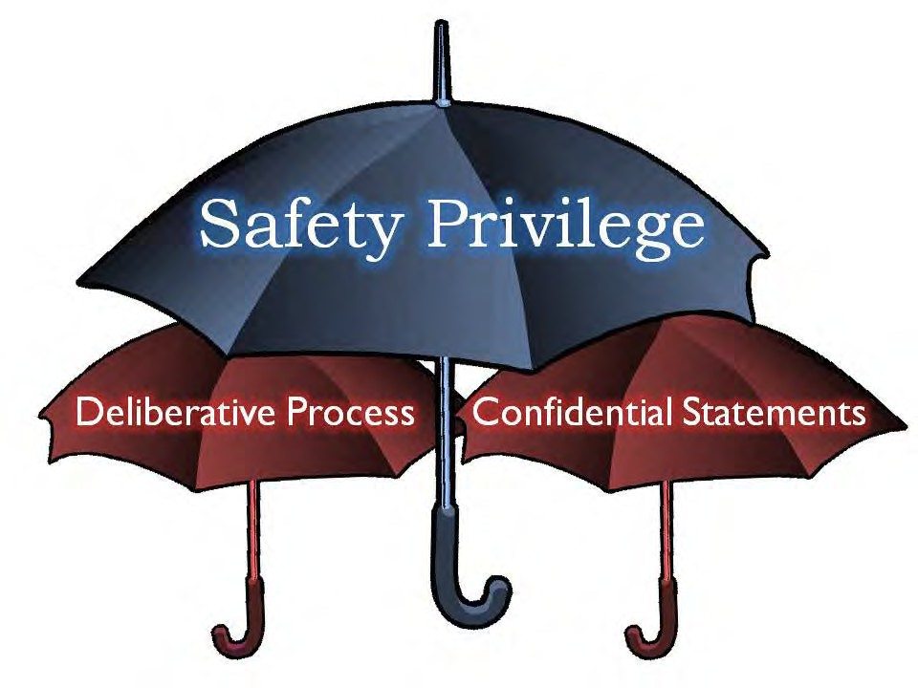
Purpose of Safety Privilege
Two parts to this privilege:
  Promise of Confidentiality (PoC)
  Deliberative process
    Findings, conclusions, recommendations, deliberations, and analysis are privileged and protected from public release.
    NOT tied to PoC.

Slide 4
Promise of Confidentiality
Who can offer a PoC?
  Interim Safety Board (ISB) – Board President (BP) or Investigating Officer (IO)
  Safety Investigation Board (SIB) – BP or IO
    Only BP or IO may authorize other SIB members to extend the offer to the witness.
  Single Investigating Officer (SIO)

Slide 5
Promise of Confidentiality
Who can receive a PoC?
  Any witness (Aviation Mishaps)
  Analysts
  Contractor who built the equipment
Not all witnesses need / require a PoC.

Slide 6
Deliberative Process
Those products produced by the SIB showing analysis or having data origins in privileged interviews are privileged. This includes, but is not limited to
  Findings, conclusions, causes, recommendations, other findings and recommendations of significance in the SIB’s report.
  Information given to safety investigators pursuant to a PoC.
  Computer generated animations, simulations, or simulator reenactments in which safety investigator analysis or privileged testimony is incorporated.

Slide 7
Deliberative Process
Other products of the deliberative products that are privileged:
  Life Sciences material that contain analysis by a safety or life sciences investigator.
  Photographs, imagery, reports, and animations that reveal the deliberative process of the board, including photographs with markings.

Slide 8
Deliberative Process
Safety reports are developed using factual evidence, confidential testimony, etc. The resulting report is
  Controlled Unclassified Information (CUI).
  For mishap prevention use only.
With very narrow exceptions, privileged information may not be used for purposes other than mishap prevention. This includes
  Disciplinary action.
  Release to the public.
  Claims for or against the government.
This creates restrictions on handling and releasing information contained within safety investigation reports.

Slide 9
Protecting Privilege
Who can a SIB release information to?
  Convening Authority
  MAJCOM/FLDCOM safety staff
  Air Force Safety Center (AFSEC)

Slide 10
Safety Privilege
Questions?

